Slide 1
Digital Intelligence (DQ)
Global Standards for Digital Literacy, Skills, Readiness
https://www.dqinstitute.org/dq-framework/

Slide 2
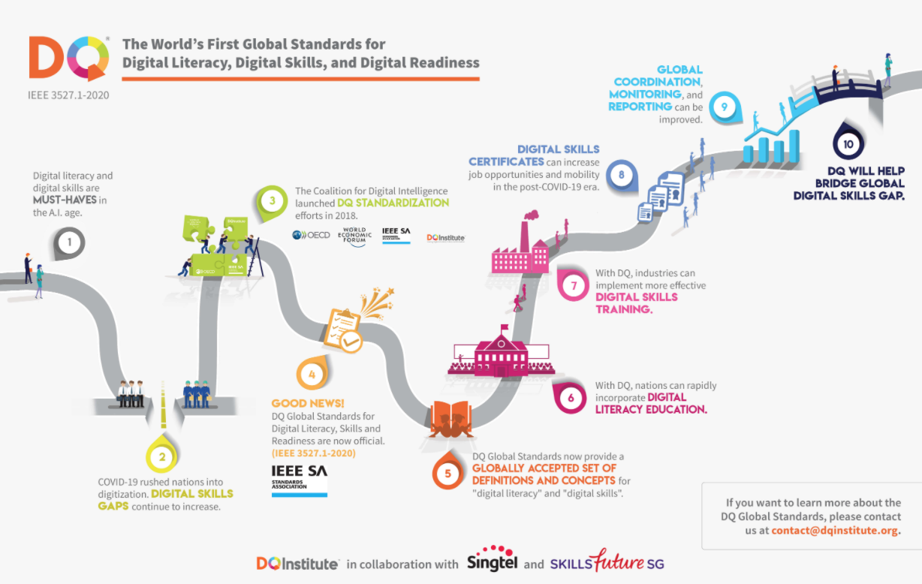

Slide 3
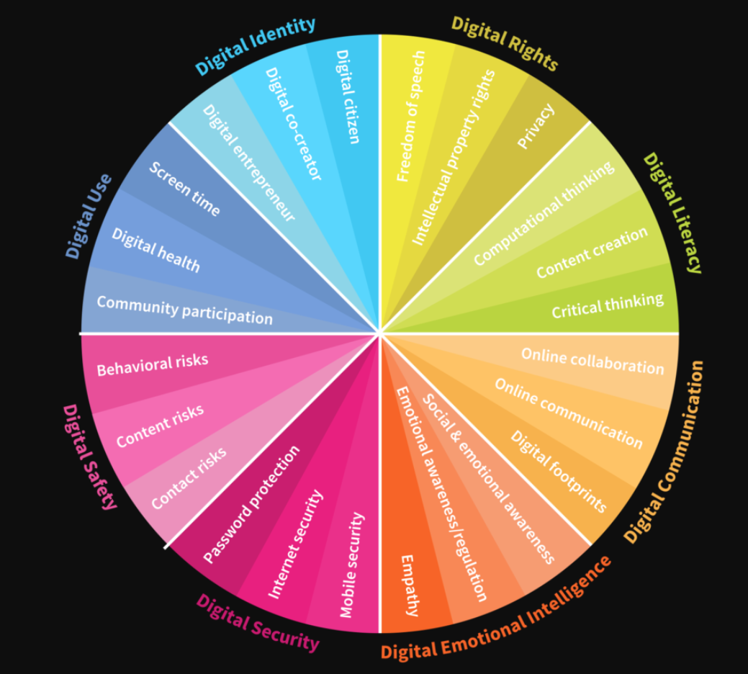

Slide 4
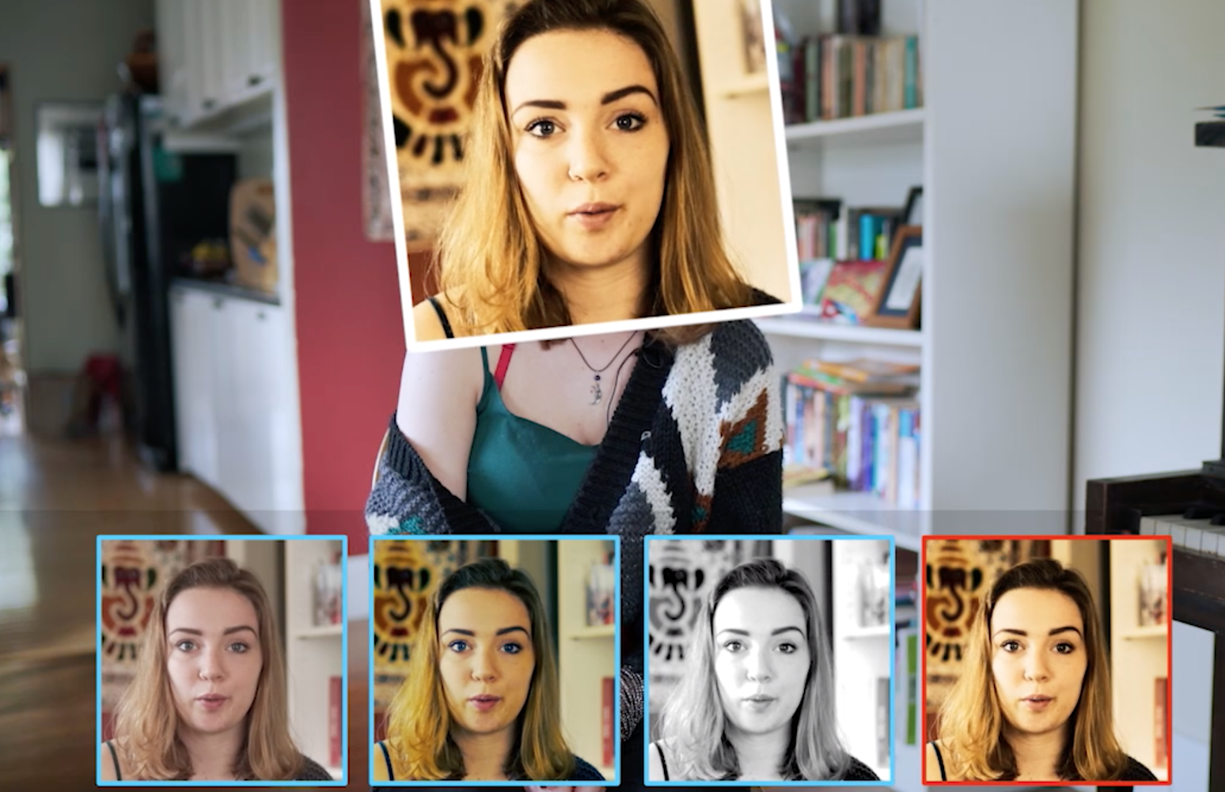
Truth About Tech: How Tech Has Kids Hooked
https://www.commonsensemedia.org/videos/the-truth-about-tech-how-tech-has-kids-hooked

Slide 5
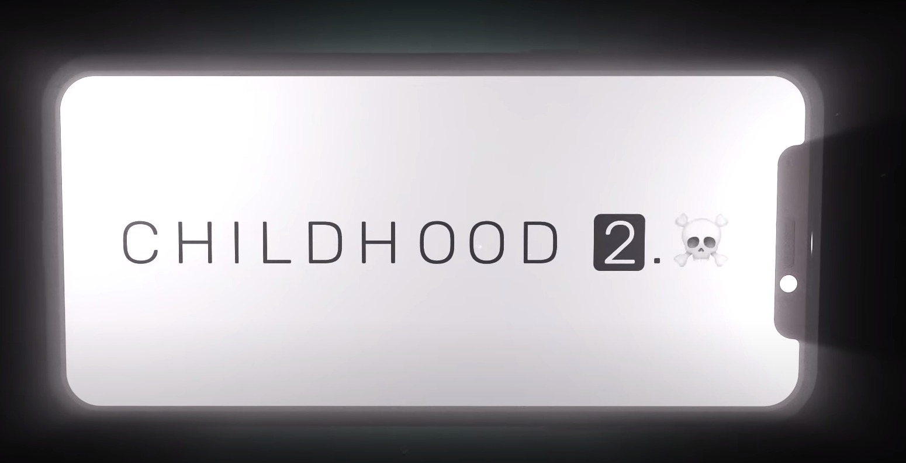
Childhood 2.0 -- Social Media Dangers Documentary
https://youtu.be/He3IJJhFy-I

